Slide 1


from hindsight to insight,
delivering
network intelligence
foresight
Notes:
Insight is generally considered to be better than hindsight because it's about understanding the present, while hindsight is about learning from the past:
Hindsight: the ability to learn from the past by looking back at what has already happened.
Insight: the ability to interpret and respond to the present by developing self-awareness and honest perception.
Foresight: the ability to predict and prepare for the future by envisioning possibilities.
When combined, hindsight, insight, and foresight can be a foundation for better decision-making and outcomes.

Slide 2
Introduction

Slide 3
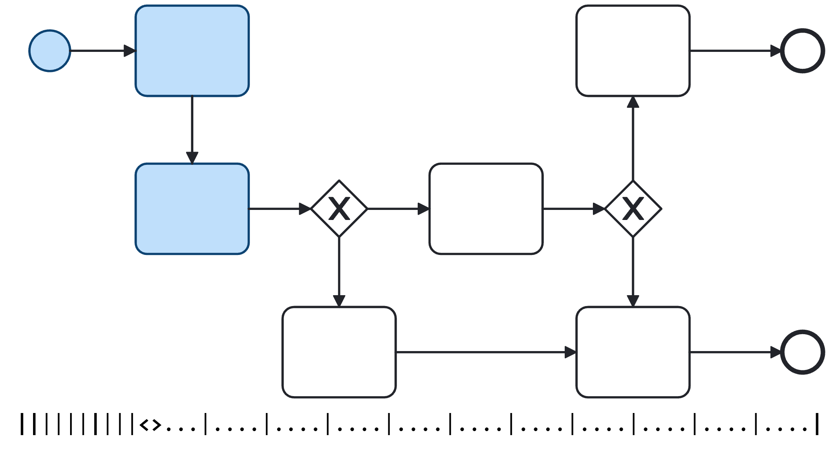
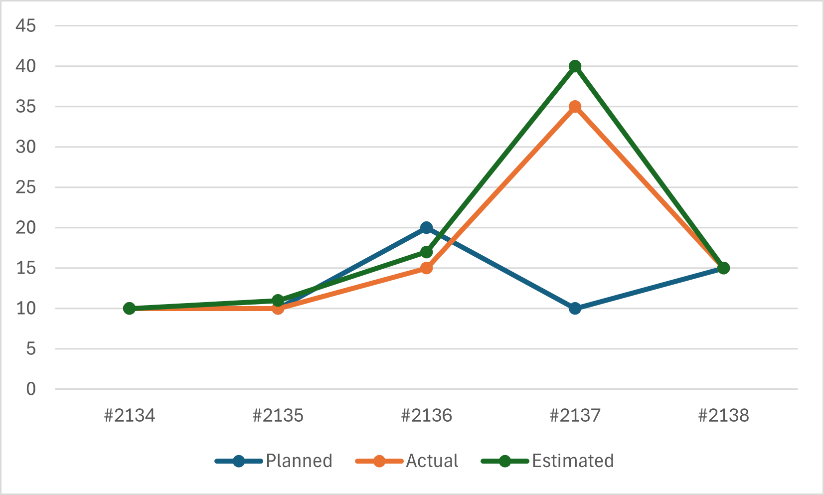
CHALLENGES
Exogenous Factors
Endogenous Factors
Any modern telecommunication business is constantly faced with finding current accurate information but also attempting to plan, coping with the ever changing “What if ?” questions from their own employees in addition to both customers and external market influences
Investors
Land
Shareholders
Operational
Effectiveness
External Influences
Business Processes
Markets
Financial
CAGR Value
Corporate Image and Brand Equity
Technology Adoption
Compliance
Regulatory
Legislation
Supply Chain
Partnerships
Land Access
Availability
Forecasting
Notes:
The slide is animated
Endogenous factors: topography, water, rocks/geology, climate, location, land use, economic characteristics, demographics
Exogenous factors: migration, economic, government rules/decisions, technology change,

Slide 4
Product portfolio (journey)
MarlinDT Network Intelligence (MNI) does not replace the fine-grain capabilities of either MarlinDT PNI or LNI, but serves to help you make decisions or, at the very least, streamline your company's decision-making processes by collecting, visualising, and communicating your data associated with your telecommunications infrastructure and services.
API-first Business Support System (BSS)
FUTURE
Extracting the value of PNI and LNI data, combing with performance indicators across past (trend), present (analytic) and future (prediction) data
2026
TODAY
TOMORROW
Common data layer stretching across the stack of data that exists today in physical and logical inventories. User Experience, one company = one integrated offering. Addressing market identified gaps before the market goes elsewhere.
Transition updating outdated technology. Reusing functional components (identity) between offerings. Single common stacks for UI and APIs. Introduction of new fine-grain Operations capability with existing functionality moving from both NetworkMining and Marlin.
The suite as an Operational Support System (OSS)
2024
2025
CLICK TO START
In the beginning
2020
From different origins, NetworkMining and Marlin GIS tools, no common branding, services nor common User Experience. Mix of outdated technology and non productized offerings
Notes:
This slide is animated

Slide 5
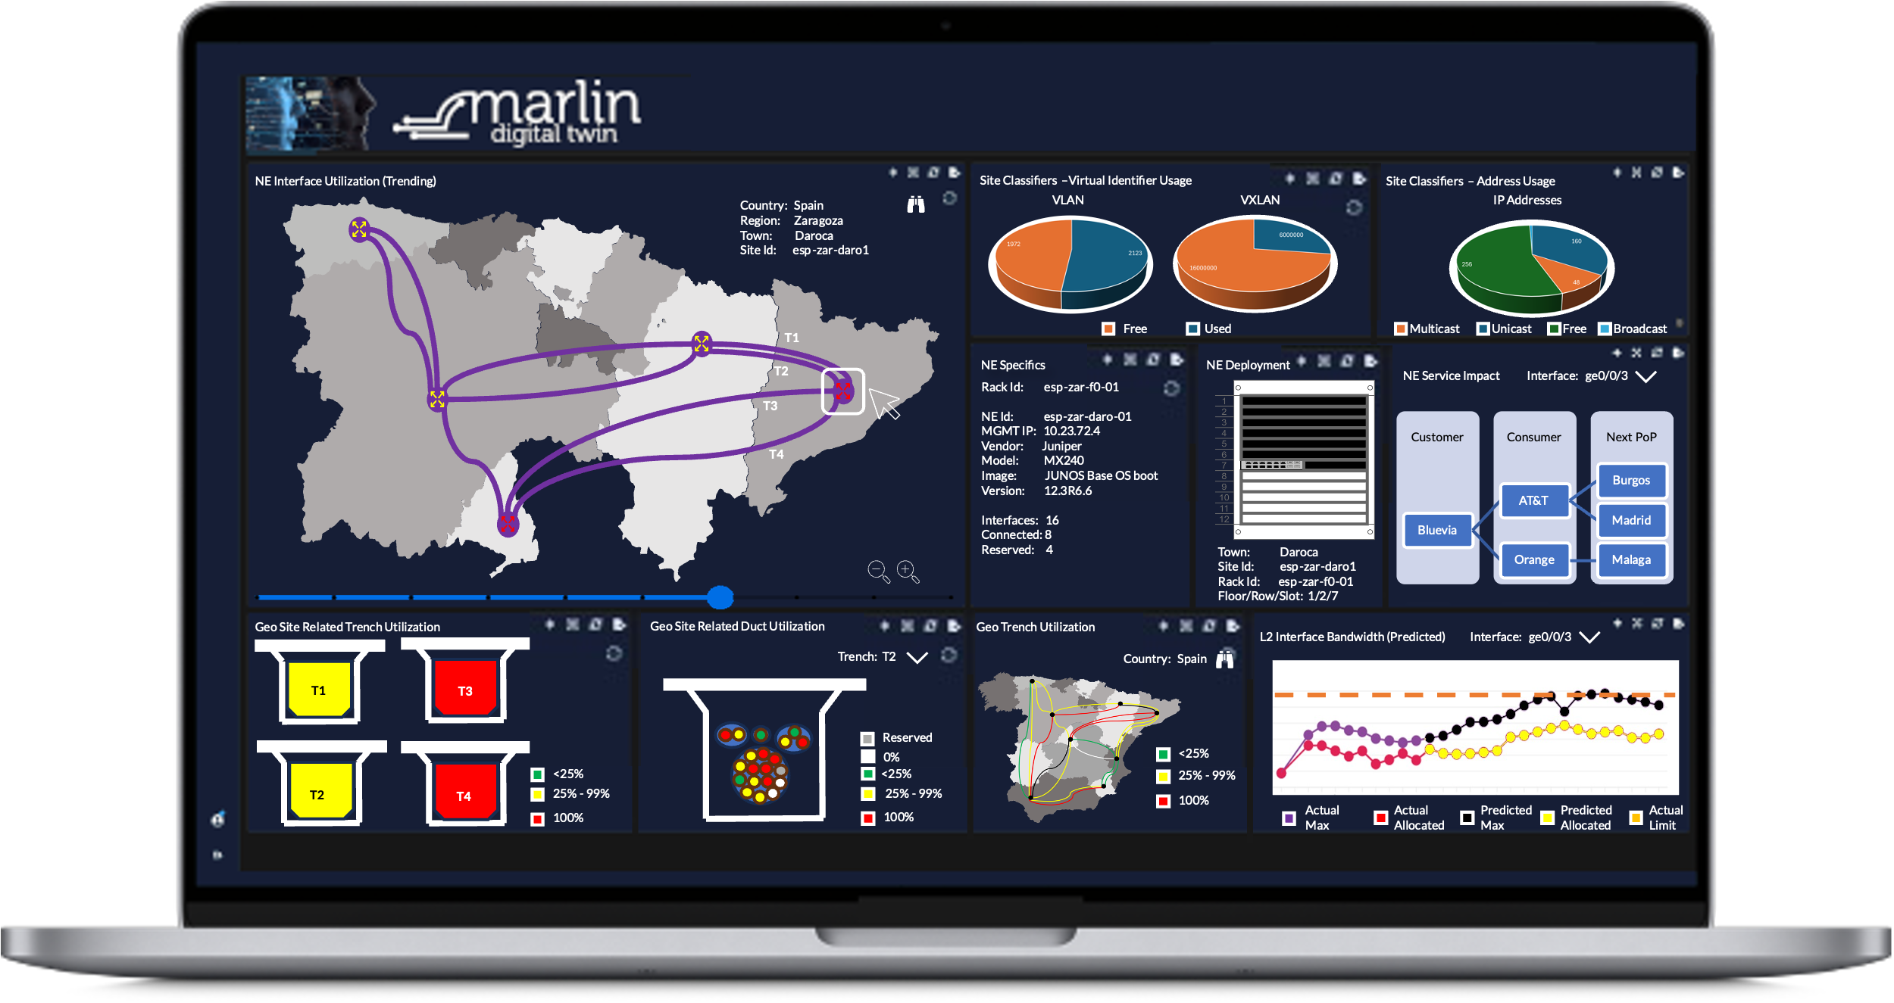
CLARITY
MarlinDT Network Intelligence uses time-series data powering rich real-time visualizations and an interactive dashboard including the reporting of analytical trends and predictions.

Slide 6
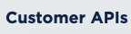
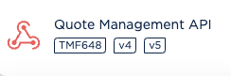
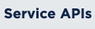
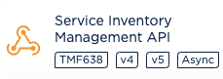
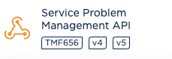
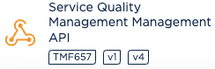
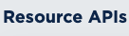
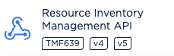
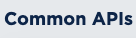
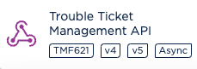
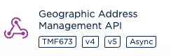
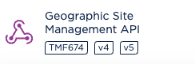
connect & feed it
Existing customers of MarlinDT can deploy an additional probe to push PNI and LNI metadata to MarlinDT Network Intelligence for processing
Those currently without MarlinDT PNI and/or LNI products, can generate and send their metadata to MarlinDT Network Intelligence for processing
MarlinDT Network Intelligence makes use of industry leading tmforum open APIs to allow rich, faster and more flexible integration to existing OSS/BSS

Slide 7
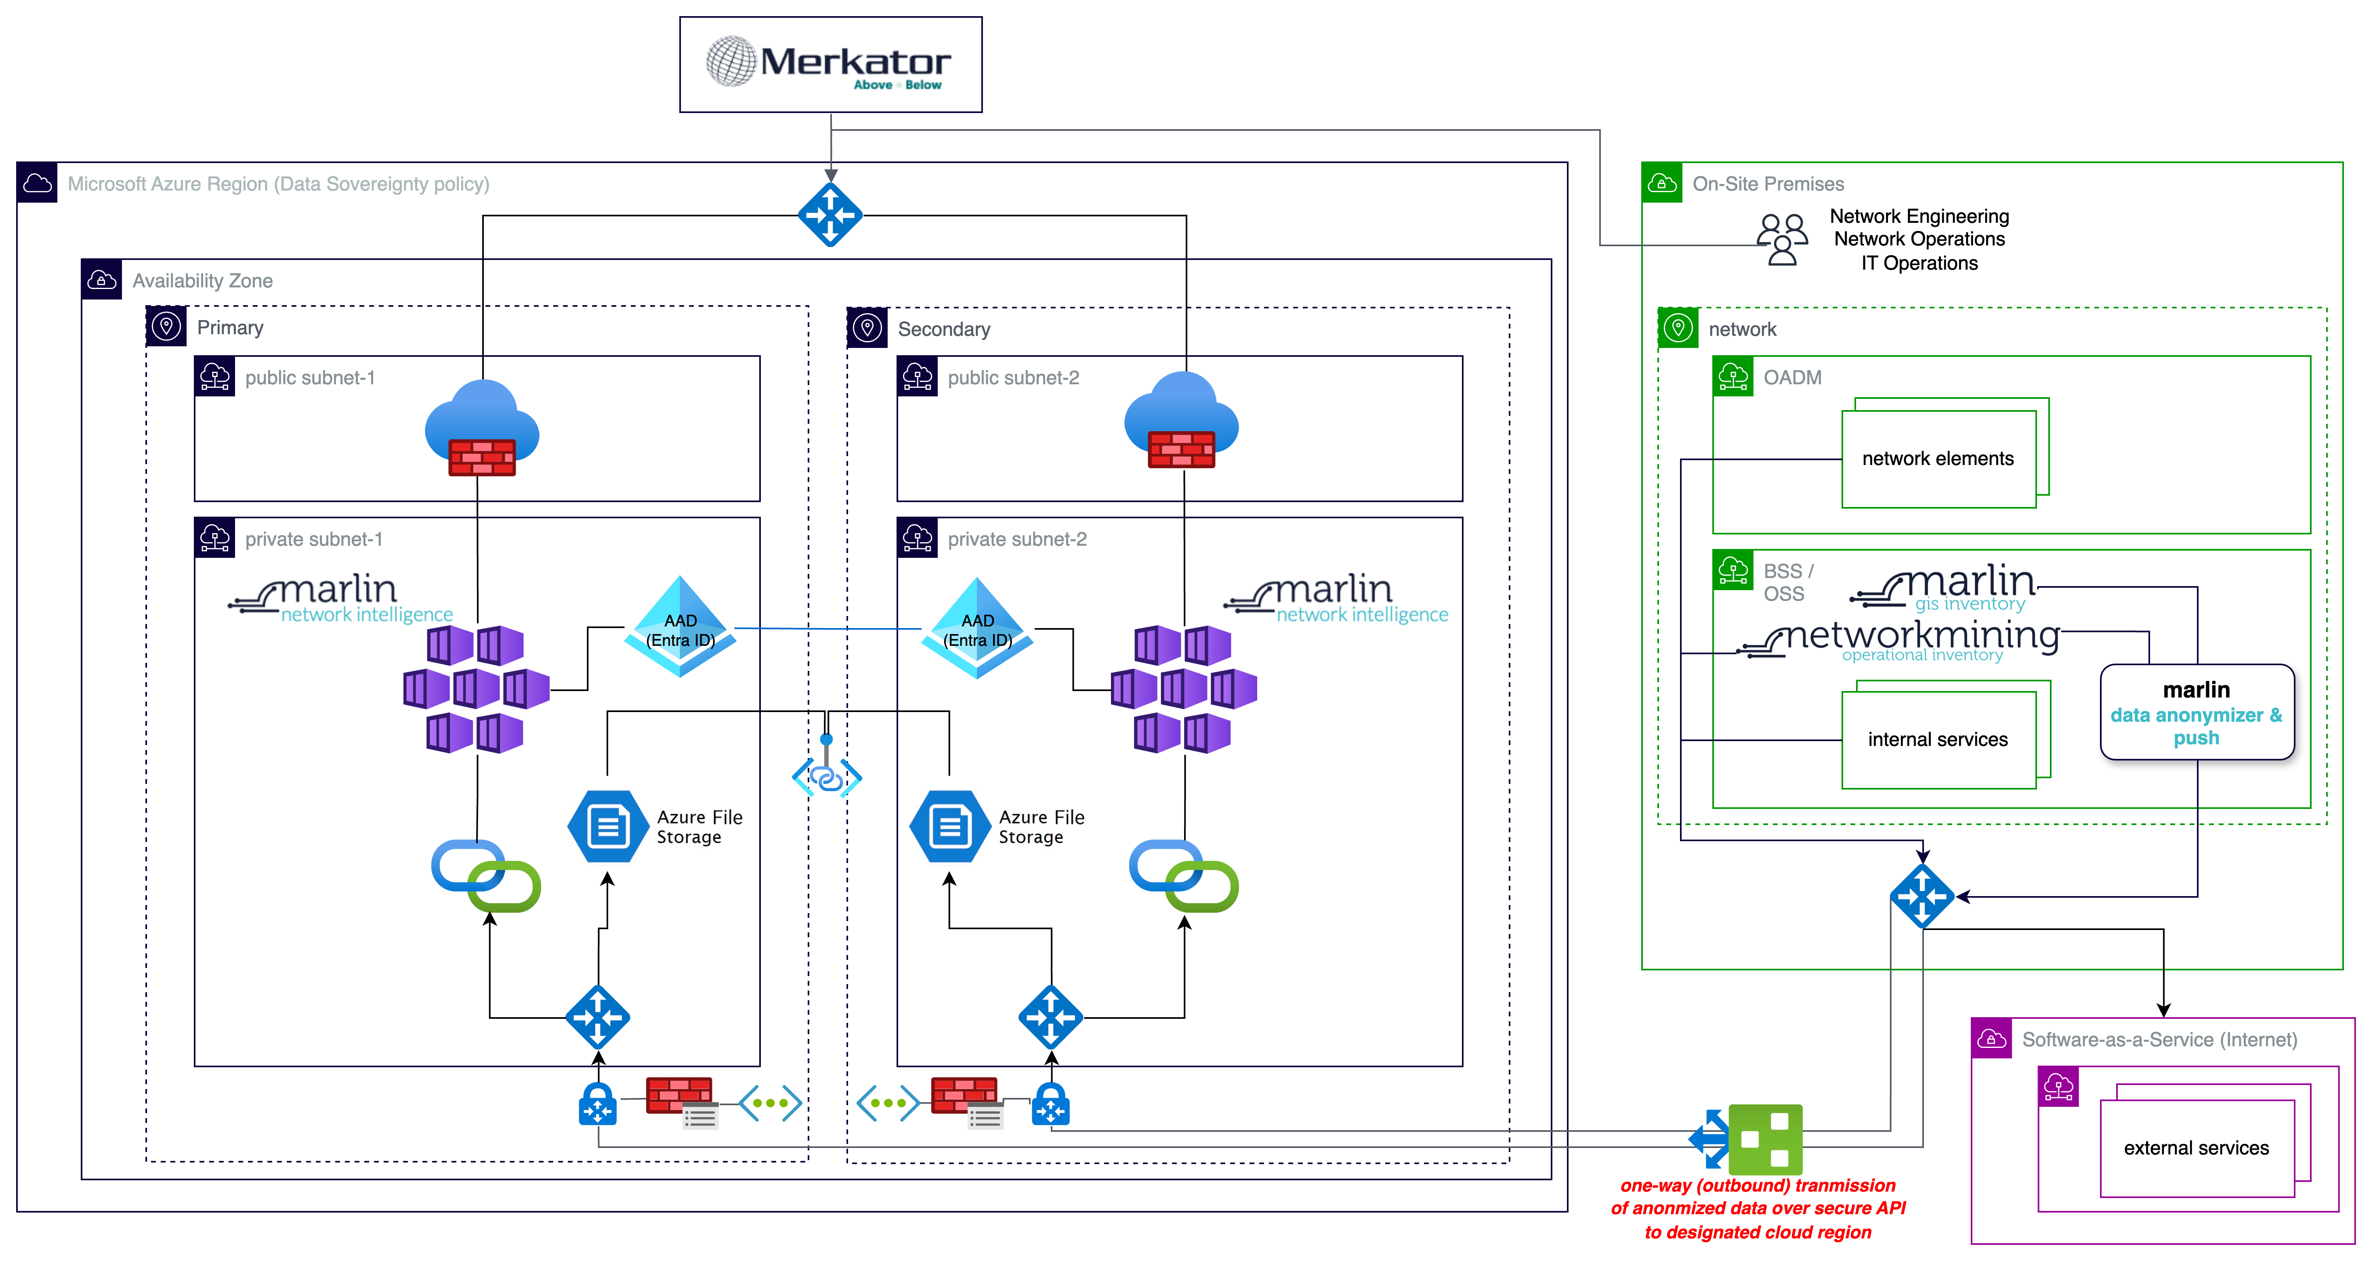
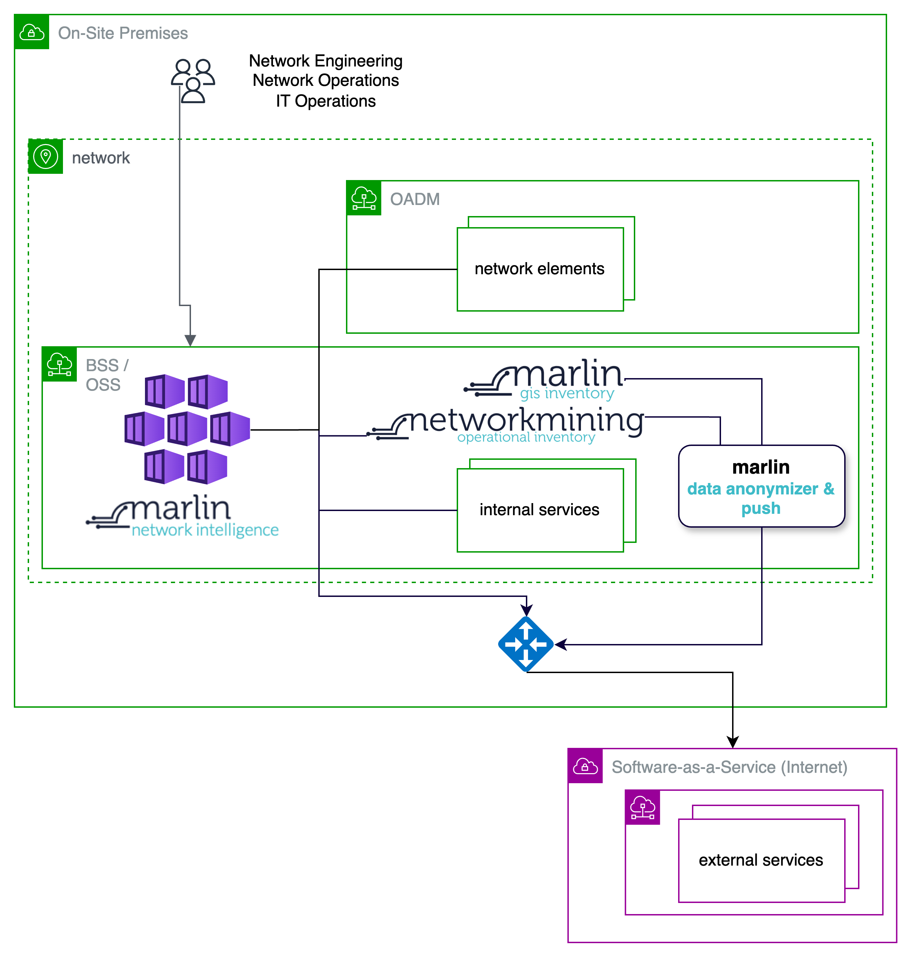
One Size Fits All
MarlinDT Network Intelligence can be deployed on-premise or to a public cloud

Slide 8
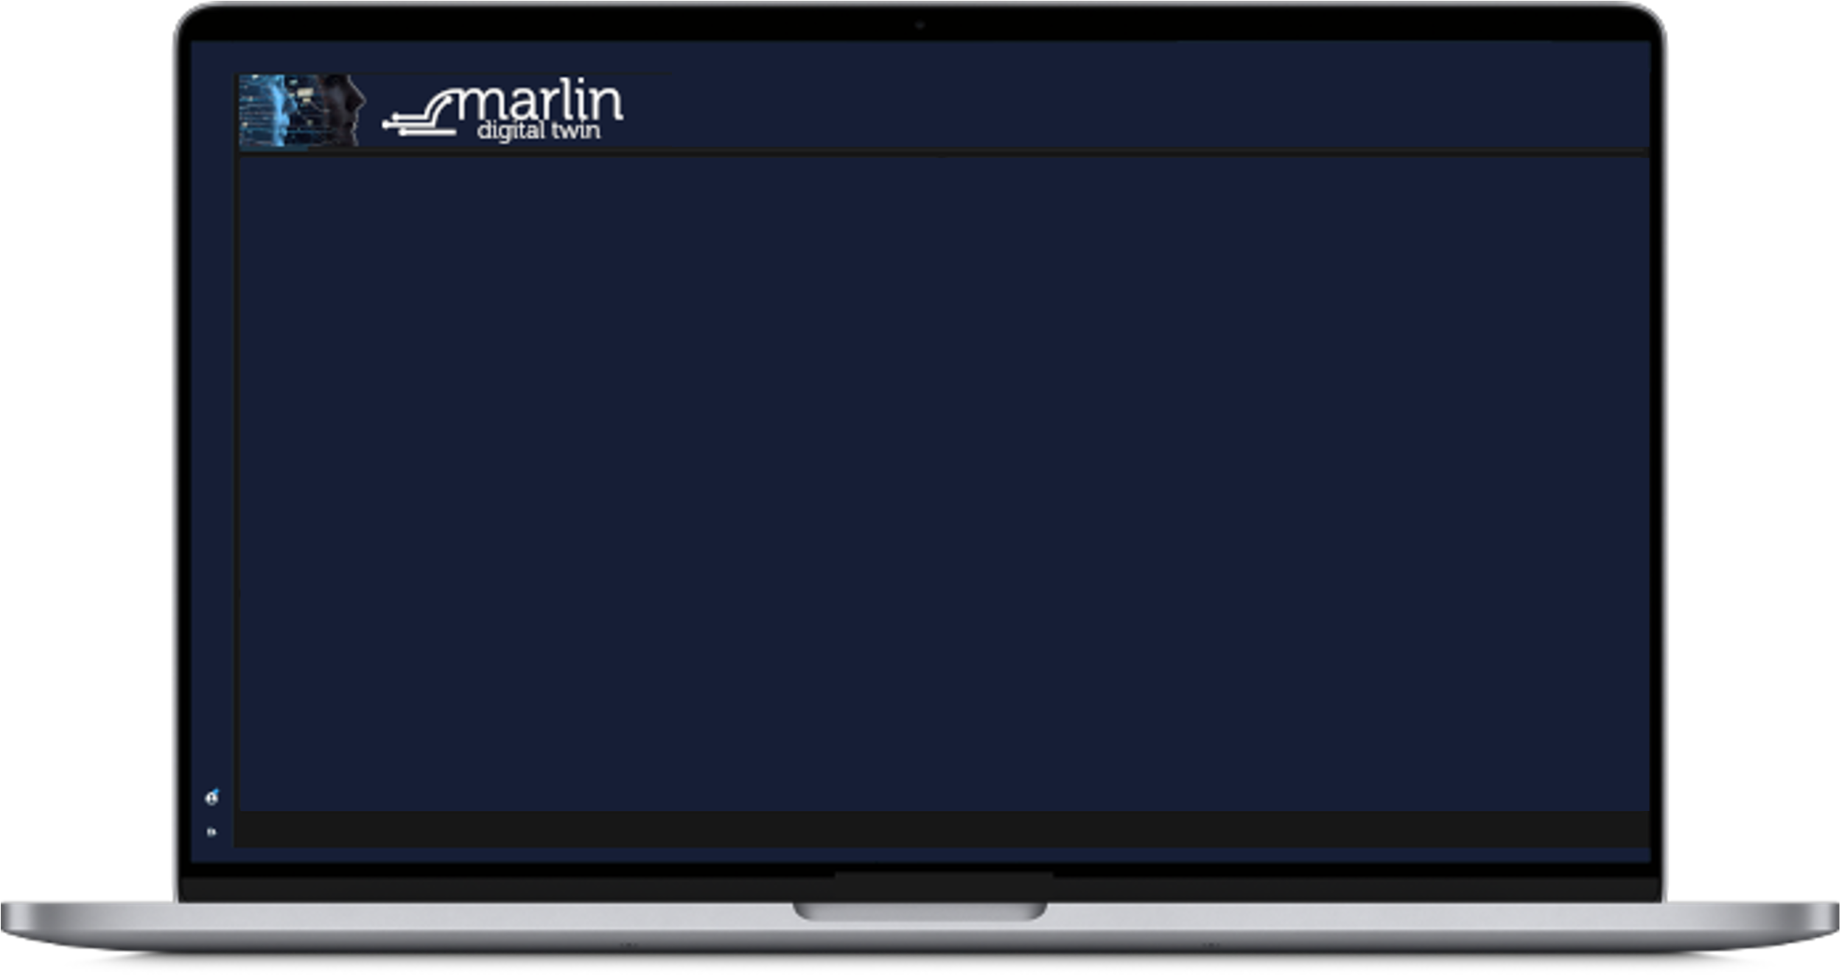
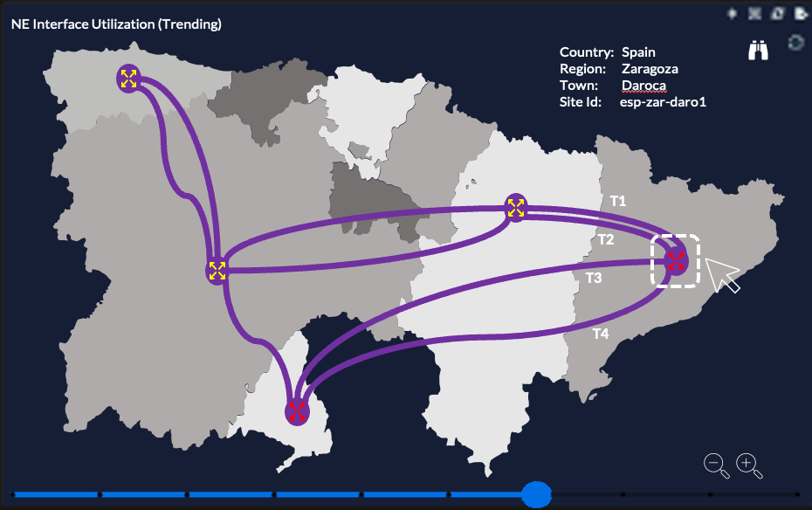
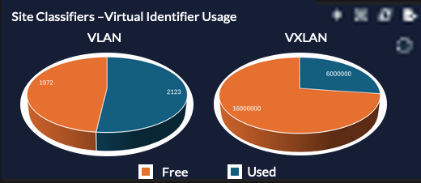
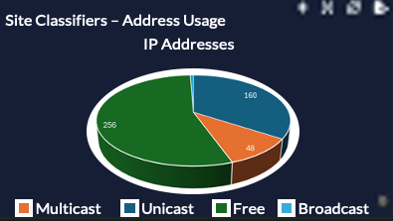
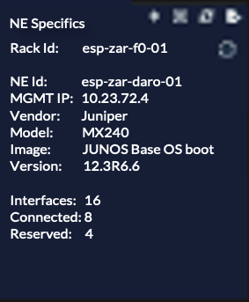
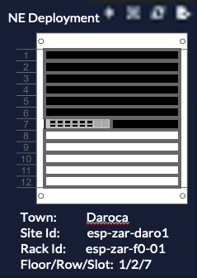
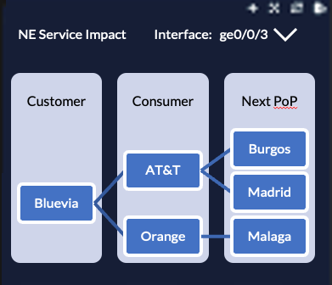
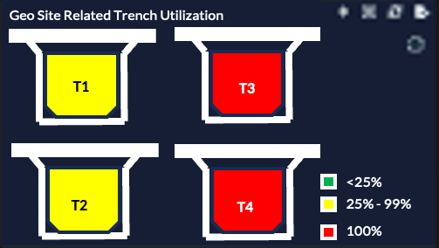
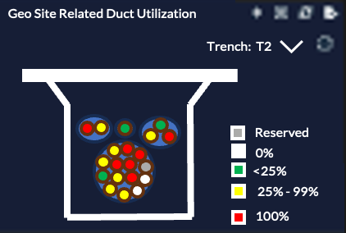
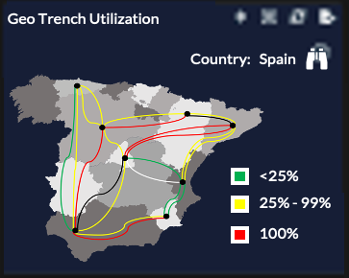
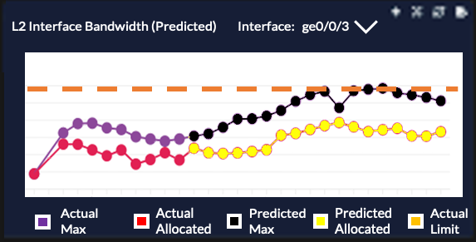
CUSTOMIZIABLE BY ALL
MarlinDT Network Intelligence provides a blank canvas, allowing infographic panels to be selected from a catalogue and placed upon it
Each canvas can be saved and re-displayed to provide for role-based personas
Some panels are context-sensitive, i.e. when another panel content/selector is changed, the panel will update to match the newly selected key data
In addition to the ever-growing MarlinDT Network Intelligence panel catalogue, additional panels can be created by the user
Notes:
This slide is animated

Slide 9
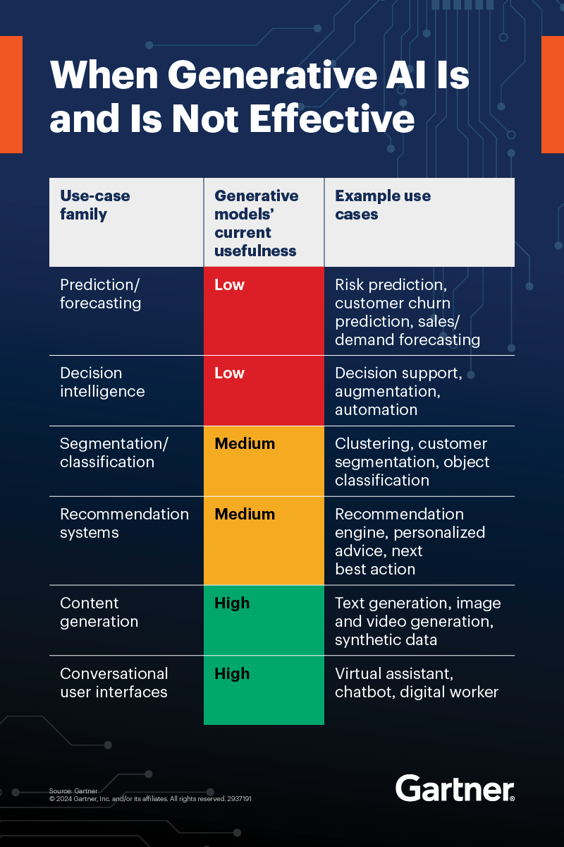


No generative ai
MarlinDT Network Intelligence will not include any form of Generative AI but can provide the necessary datasets that it may require for training purposes.
Instead, MarlinDT Network Intelligence will make use of Machine Learning for the purposes of prediction, forecasting and decision intelligence
Artificial Intelligence
Machine Learning
Deep Learning
Generate AI
MarlinDT Network Intelligence
Notes:
Machine learning is a subset of AI that allows for optimization. When set up correctly, it helps you make predictions that minimize the errors that arise from merely guessing. For example, companies like Amazon use machine learning to recommend products to a specific customer based on what they’ve looked at and bought before. Click on either Vodafone or Google Cloud logo to jump to 2024 “AI: Typical working day of Vodafone Network Engineering” 1st Gen – Bayesian Learning
An approach to machine learning where models are programmed according to Bayes’ Theorem of probability.
2nd Gen – Support Vector Machines (SVM)
A supervised machine learning algorithm used for classifying or regression of data objects.
3rd Gen – Maximum Entropy Discrimination (MED)
A successor to SVM, MED uses the maximum entropy principle to spot anomalies in partially labelled datasets.
4th Gen – Active Learning Combined with MED
A machine learning technique where an algorithm actively requests a user to label certain data points.
5th Gen – Active Feedback Combined with MED
A machine learning technique where a user corrects mislabelled data in a dataset.
6th Gen – Deep Learning
A subset of machine learning using layers of algorithms loosely based on the neural networks in the human brain.

Slide 10
INDUSTRY PLUGGABLE - tmforum open APIs (proposed)
open API | MarlinDT Network Intelligence use
TMF621 Trouble Ticket Management API provides a standardized client interface to Trouble Ticket Management Systems for creating, tracking and managing trouble tickets among partners as a result of an issue or problem identified by a customer or another system. Examples of Trouble Ticket API clients include CRM applications, network management or fault management systems, or other trouble ticket management systems (e.g. B2B). | consumes external data via TMF621 for collection of trouble tickets for alarm metrics
TMF638 Service Inventory Management API the intent of this API is to provide a consistent/standardized mechanism to query and manipulate the Service inventory | consumes service inventory data via TMF638
TMF639 Resource Inventory Management API the intent of this API is to provide a consistent/standardized mechanism to query and manipulate the Resource inventory. | consumes resource inventory data via TMF639
TMF656 Service Problem Management (SPM) API the SPM API is used to manage service problems. Service problems are generated based on the information declared by a partner or the event information notified from infrastructure providers. The event information includes alarm information, performance anomaly information, trouble ticket information, SLA violation, maintenance information, and prediction information. | consumes external data via TMF656 for collection of alarms/performance metrics
TMF657 Service Quality Management Management (SQMM) API using the SQMM API, any Enterprise is able to access a Service Quality Management application and extract Service Level Specifications and associated Service Level Objectives (SLO) and their thresholds. | consumes external data via TMF657 for collection of SLO thresholds
TMF673 Geographic Address Management API provides a standardized client interface to an Address management system. It allows looking for worldwide addresses. It can also be used to validate geographic address data, to be sure that it corresponds to a real geographic address. Finally, it can be used to look for a geographic address by: searching an area as a start (city, town ...), then zooming on the streets of this area, and finally listing all the street segments (numbers) in a street. | provides this API to assist selection and navigation
TMF674 Geographic Site Management API covers the operations to manage (create, read, delete) sites that can be associated with a customer, account, service delivery or other entities. This API defines a Site as a convenience class that allows easy reference to places important to other entities, where a geographic place is an entity that can answer the question “where? | provides this API to allow for the management of sites for network topology and infrastructure build-outs
TMF648 Quote API is one of the Pre-Ordering Management APIs. The customer Quote API provides a standardized mechanism for placing a customer quote with all the necessary quote parameters. | will (in the longer term) provide this API to allow the provision of quotes for future supply of new infrastructure and services. In the operational now of MarlinDT Network Intelligence, these will be seen as future changes and if the quote is subsequently accepted by the end-customer will automatically initiate plan and design flows in MarlinDT PNI and update MarlinDT LNI aspects (i.e. sites) which would not be discovered through LNI probes.
© 2024-2025 Merkator nv/sa. All rights reserved

Slide 11
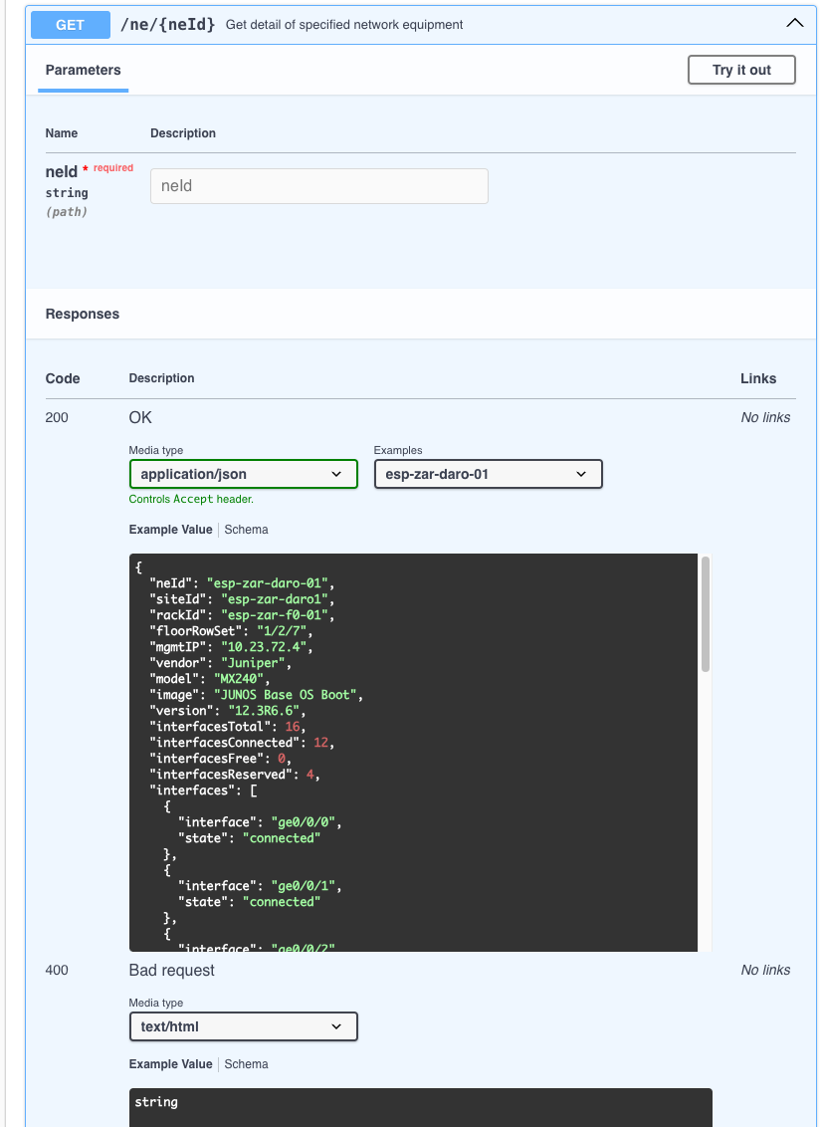
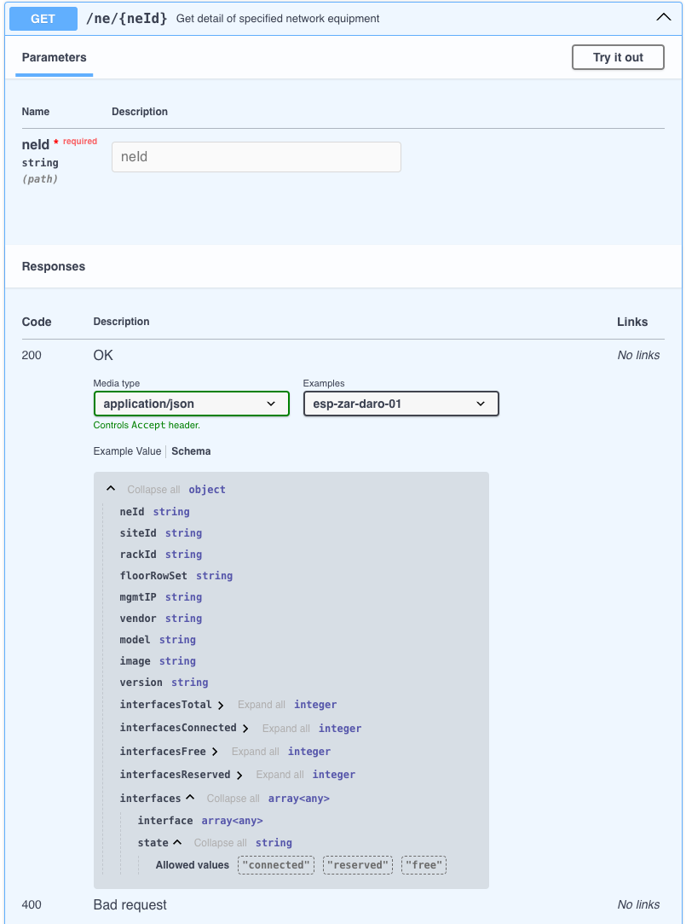
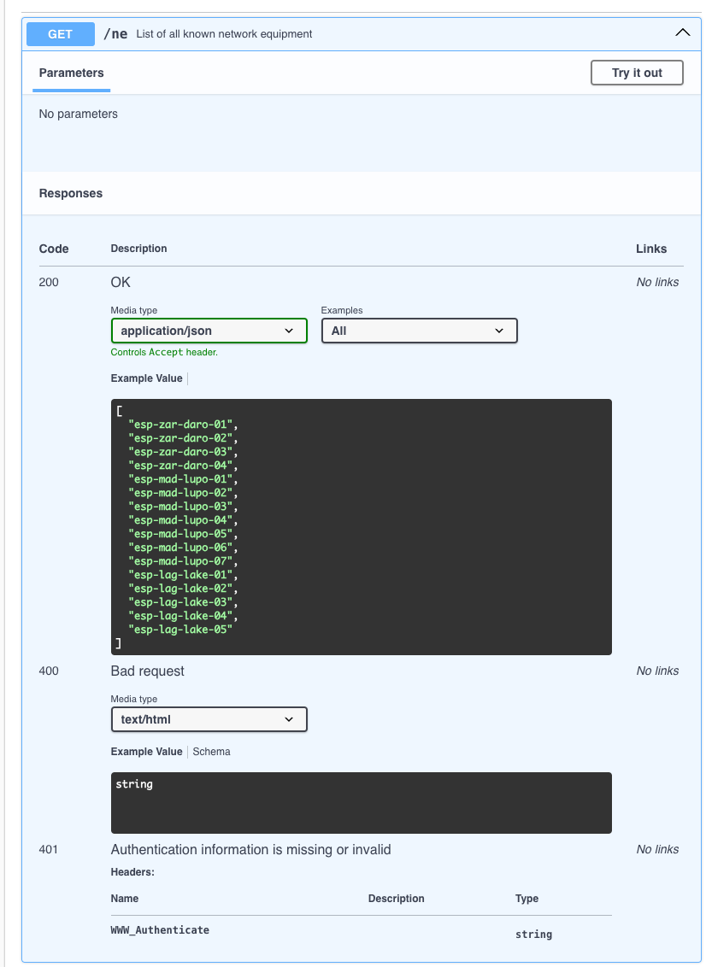
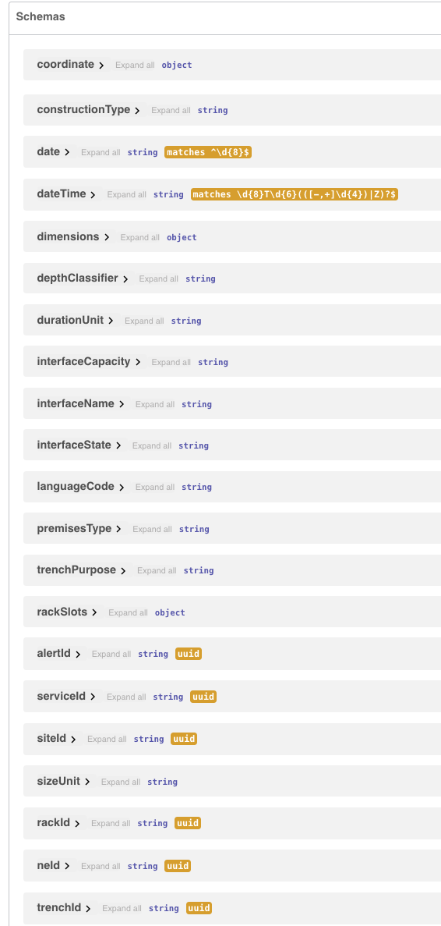
DEVELOPER FRIENDLY
MarlinDT Network Intelligence includes Open API (swagger) Specification to aid developer integration including request and response definitions, schemas and examples
© 2024-2025 Merkator nv/sa. All rights reserved
Notes:
This slide is animated

Slide 12
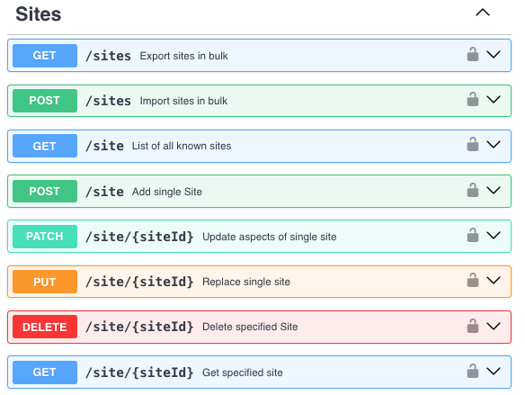
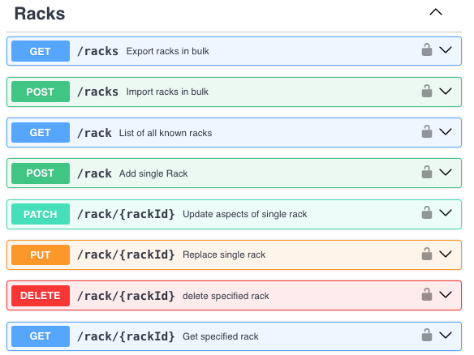
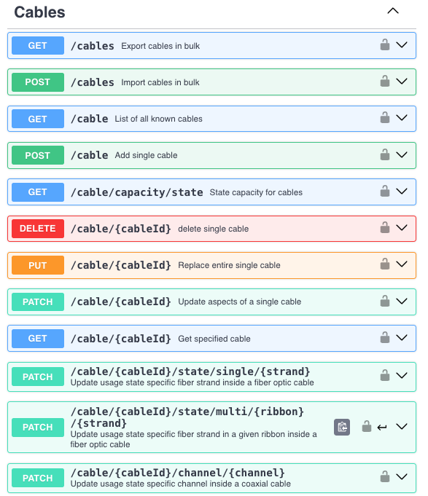
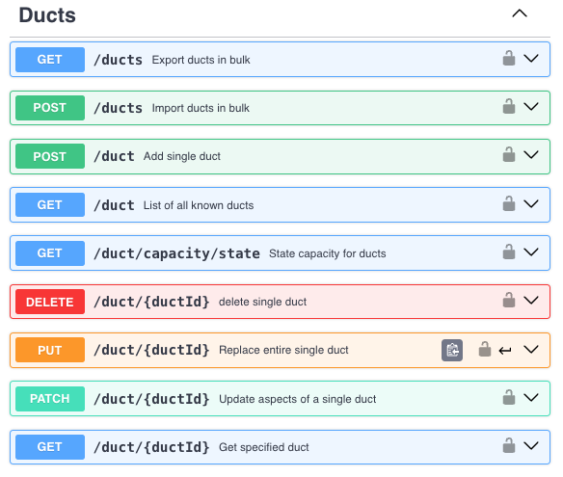
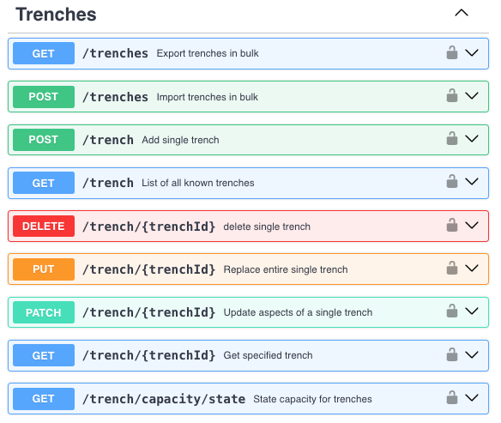
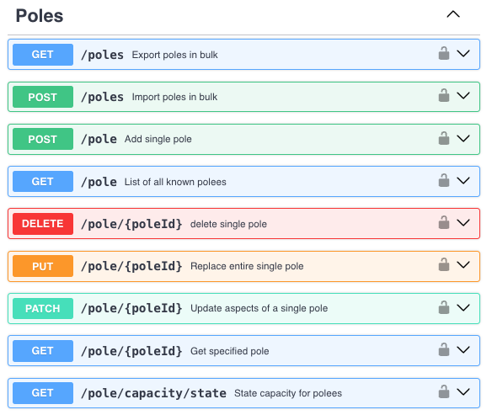
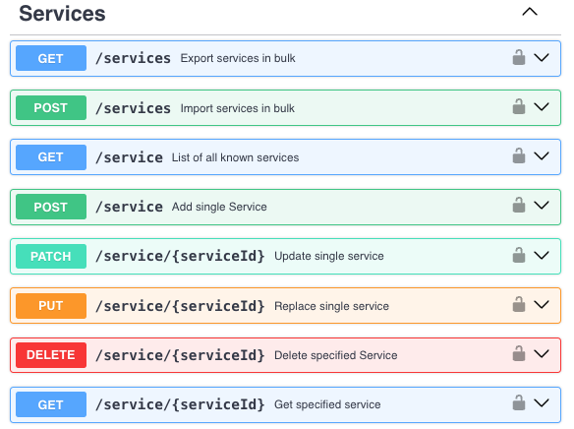
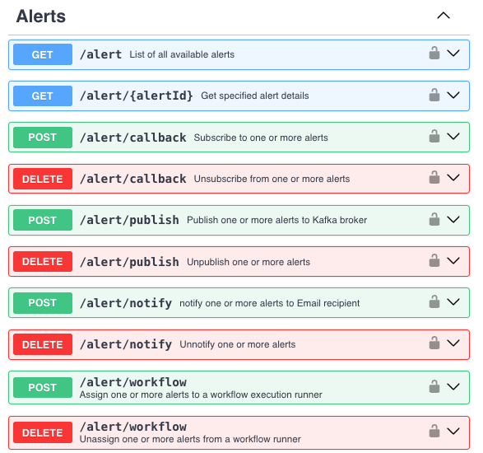
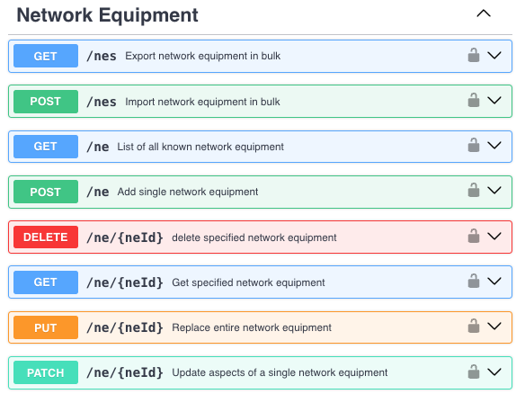
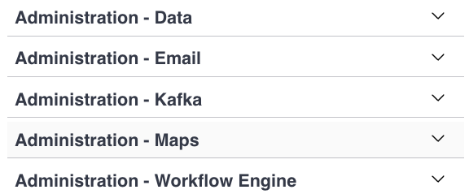

api-first Methodology
© 2024-2025 Merkator nv/sa. All rights reserved
Historical/Predicted date (point in time, past or future) specified via query parameter on HTTP GET calls
API Gateway configuration generated from Open API definition
API Server stubs generated from Open API definition
Automatic testing will be against Open API definition
Notes:
API-First - https://thenewstack.io/adopting-an-api-first-strategy-to-empower-developers/ - https://thenewstack.io/why-api-first-matters-in-an-ai-driven-world/

Slide 13
Network Intelligence Catalogue

Slide 14













AVAILABLE KPI
Work Planning Active Sessions
Work Planning Efficiency
Physical Trench / Duct Utilization
Geographical Trench Utilization
Physical Duct/Fiber Utilization
Transmission Capacity
Rack Capacity
Rack Equipment
Network Equipment Interface Utilization
Network Equipment Interface Bandwidth
Network Equipment Interface Error Rates
Switching/Routing Classifiers
List of Trenches / Poles
Trench / Pole Detail (inc. premises passed)
Trench / Pole Service Impact
List of Ducts
Duct Detail (duct, sub-duct)
List of Cables
Cable Detail (coax, copper, single/mutli fiber)
List of Racks
Rack Detail
List of Network Equipment
Network Equipment Detail
Network Equipment Service Impact
Data Quality Issues
Each offers one or more vantage points
Actual
Trending
© 2024-2025 Merkator nv/sa. All rights reserved
Predictive
Panel
API
Near-Real Time Alert

Slide 15
Near Real-Time Alerts

Slide 16










Near real-time alerts
Work Planning Active Sessions
Work Planning Efficiency
Physical Trench / Duct Utilization
Geographical Trench Utilization
Physical Duct/Fiber Utilization
Transmission Capacity
Rack Capacity
Rack Equipment
Network Equipment Interface Utilization
Network Equipment Interface Bandwidth
Network Equipment Interface Error Rates
Switching/Routing Classifiers
List of Trenches / Poles
Trench / Pole Detail (inc. premises passed)
Trench / Pole Service Impact
List of Ducts
Duct Detail (duct, sub-duct)
List of Cables
Cable Detail (coax, copper, single/mutli fiber)
List of Racks
Rack Detail
List of Network Equipment
Network Equipment Detail
Network Equipment Service Impact
Data Quality Issues
Customizable thresholds
Custom workflow
Publish to Kafka streaming platform
Integration to Microsoft Exchange
Low-Code/No-Code workflow
Webhook (async callback)
Stream
Email
Desktop Notification

Slide 17
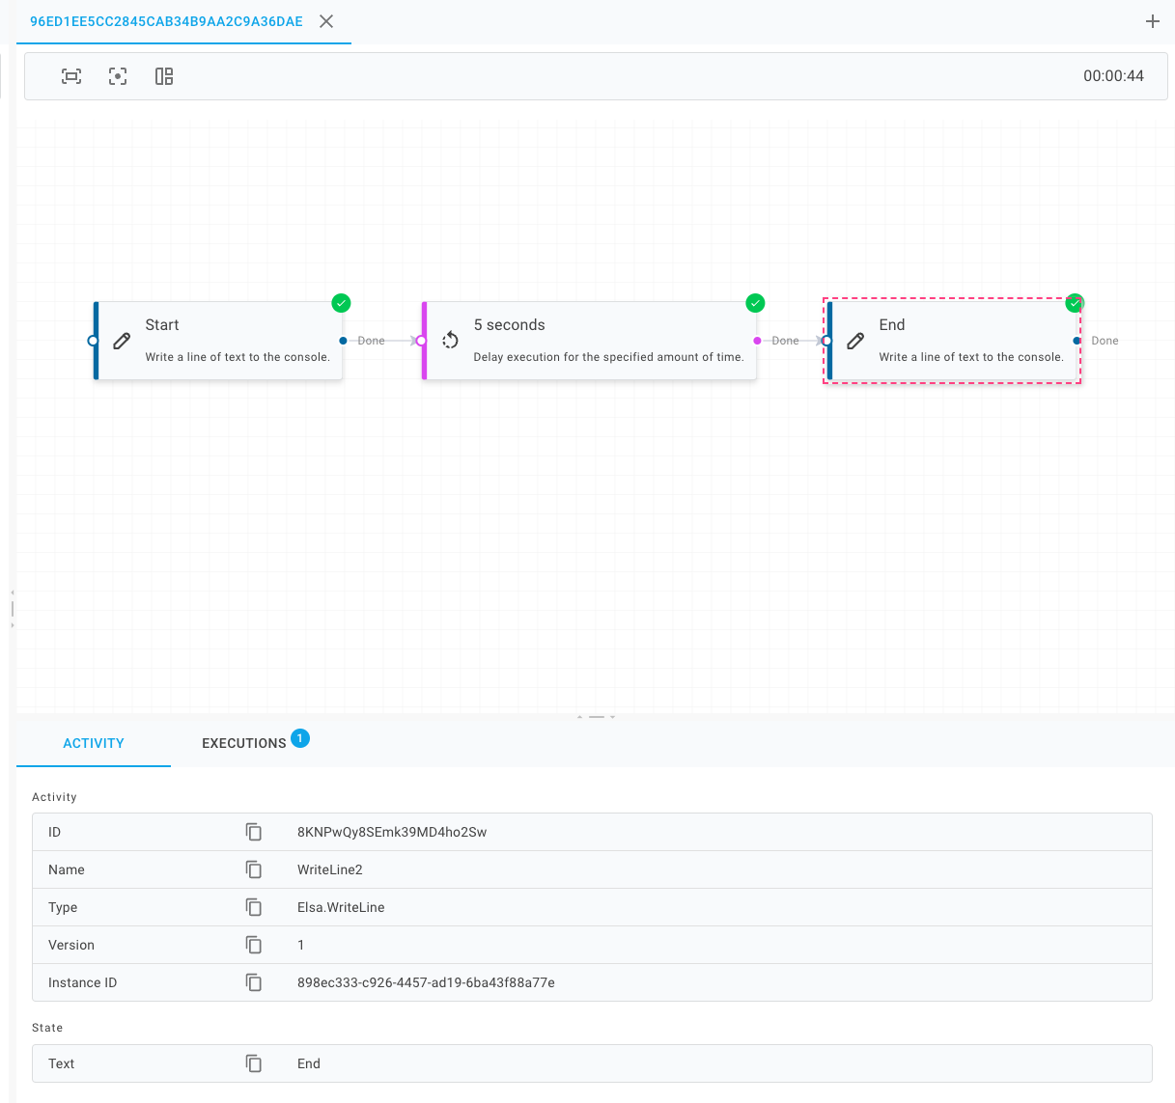
LOW-CODE/NO-CODE: NEAR REAL-TIME ALERT
For generated alert(s)
Start (log via console)
Wait 5 seconds
End (log via console)

Slide 18
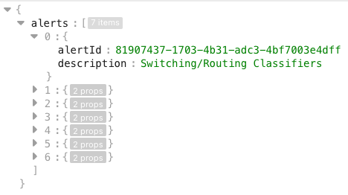
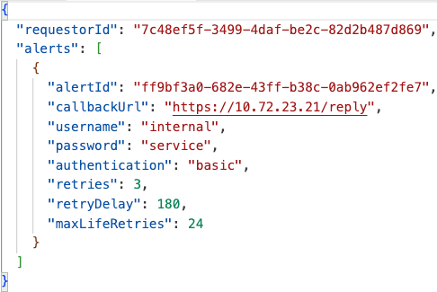
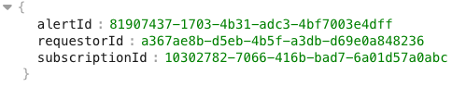
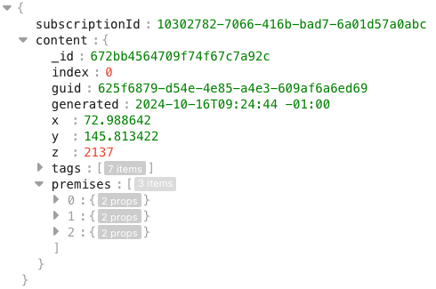
WEBHOOK: NEAR REAL-TIME ALERT
/mni/v1/alert
1
GET
2
RESPONSE
Get id of alert(s)
Subscribe to alert(s)
Receive alert events
Unsubscribe from alert(s)
/mni/v1/alert/callback
3
POST
4
RESPONSE
https://10.72.23.21/reply
#
POST
MNI
10.72.23.21
1
2
DELETE
3
##
/mni/v1/alert/callback?requestorId=a367ae8b-d5eb-4b5f-a3db-d69e0a88236&subscriptionId=(10302782-7066-416b-bad7-6a01d57a0abc)
#
##
Notes:
This slide is animated

Slide 19
Architecture & Data Model

Slide 20
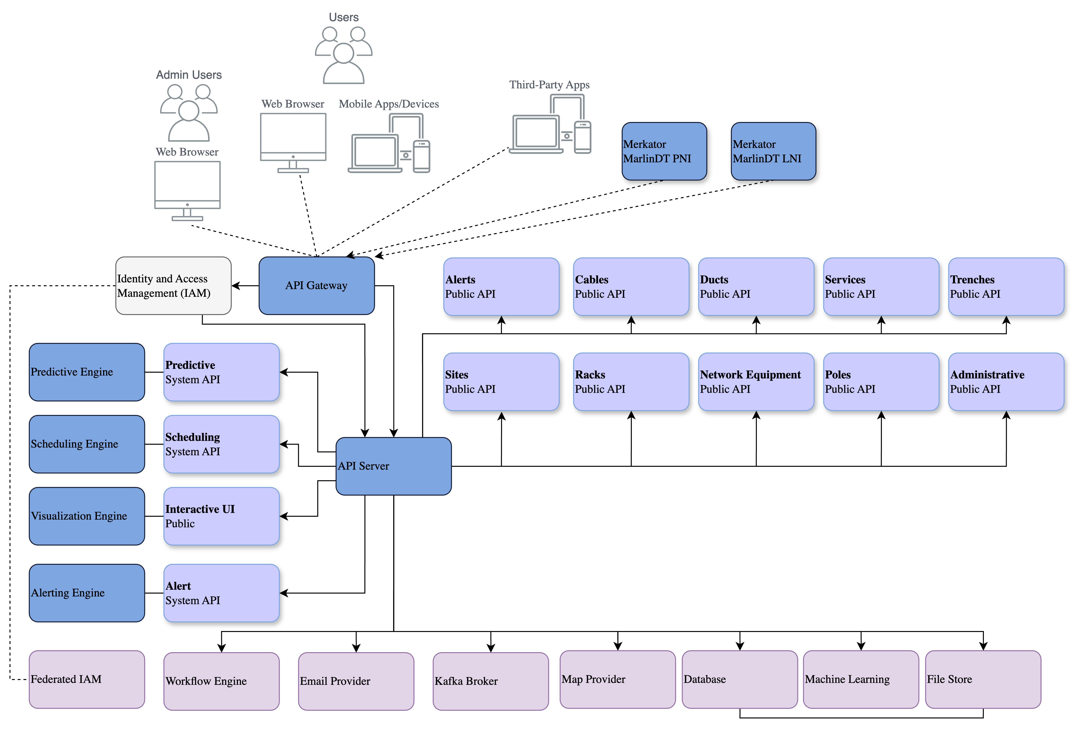
Architecture: functional

Slide 21
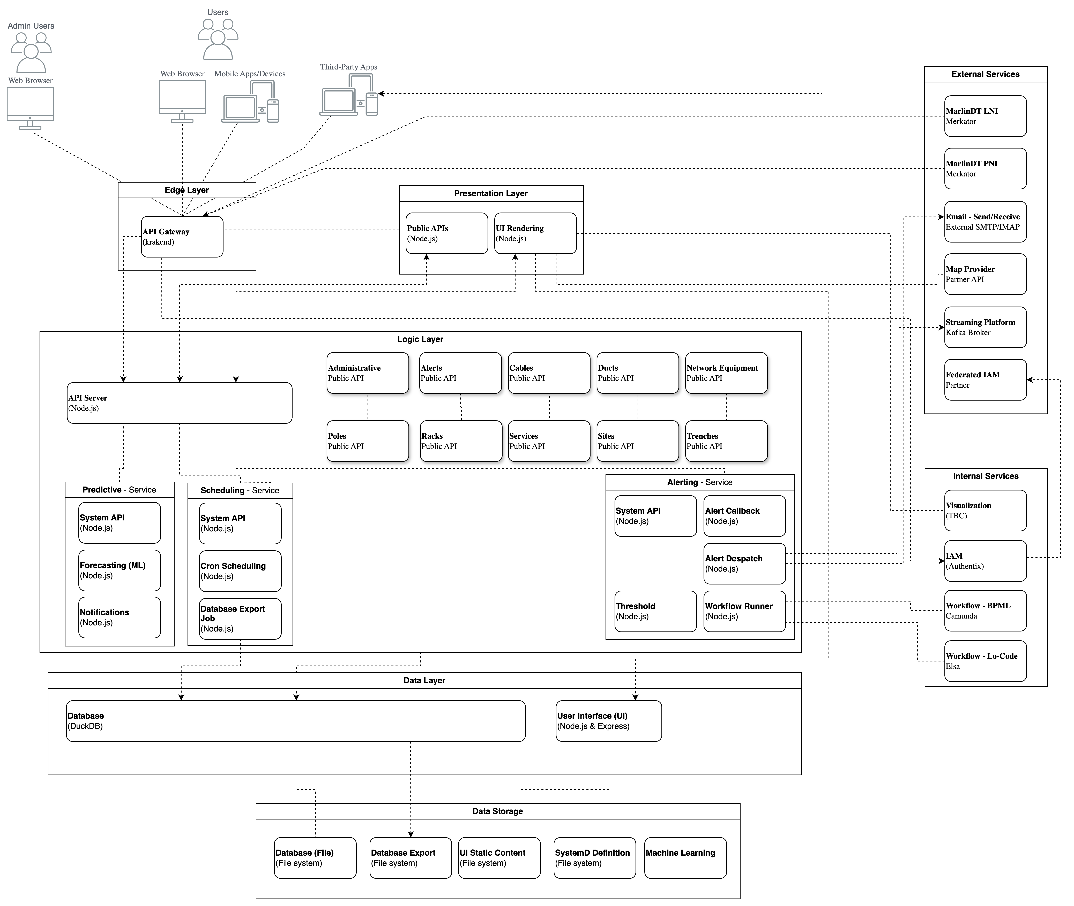
Architecture: Application

Slide 22

Architecture: Data

Slide 23

Architecture: Security

Slide 24

Architecture: Integration

Slide 25

Architecture: DevOps Pipeline (Proposed)

Slide 26

DATA MODEL: HIGH-LEVEL

Slide 27
DATA MODEL (Fine-Grain)

Slide 28
Database: duckdb vs. snowflake
Standard SQL | ACID Compliant (Atomicity, Consistency, Isolation & Durability) | Ideal Dataset Size | Data Formats (CSV, JSON, Parquet) | Environment | Cost
Snowflake: Yes DuckDB: Yes | Snowflake: Yes DuckDB: Yes | Snowflake: Large DuckDB: Small to Medium | Snowflake: Yes DuckDB: Yes | Snowflake: Cloud DuckDB: Embedded | Snowflake: $ DuckDB: 0 (free)
DuckDB is an in-memory analytical database written in C++. It is designed to support analytical queries, similar to SQLite, but with a focus on analytic.
DuckDB is designed to be used as an embedded database, similar to SQLite. This means it runs within the same process as the application and does not require a separate server process.
DuckDB is designed to be fast, with vectorized execution and advanced query optimization techniques.
DuckDB can be used with various data science tools
Snowflake is a cloud-based data warehousing platform that separates compute and storage resources, enabling each to scale independently.
Snowflake architecture allows for a high degree of flexibility and performance optimization.
Snowflake is designed to handle large volumes of data and complex queries, making it suitable for big data analytics.
Snowflake is a fully-managed service, meaning that users do not need to worry about infrastructure management or database optimization.

Slide 29
Network Intelligence Proposed Panels

Slide 30

PANEL: PHYSICAL TRENCH UTILIZATION
For selected trench
Available capacity is colour filled based on occupied vs. unoccupied from trench total volume & trench consumed volume (from sum of all ducting volume)
0% (empty) - white
<25% - green
>25% .. <99% - yellow
100% (full) - red
Reserved - gray
Utilization mix (0%,25%-99%,100%) should be configurable
Past / Current
Predicted

Slide 31
PANEL: GEOGRAPHICAL TRENCH UTILIZATION
Select geographic region
Zoom to desired scale
Display trench route
Available capacity is colour filled based on occupied vs. unoccupied from trench total volume & trench consumed volume (from sum of all ducting volume)
0% (empty) - white
<25% - green
>25% .. <99% - yellow
100% (full) - red
Reserved - gray
Utilization mix (0%,25%-99%,100%) is configurable
Past / Current
Predicted

Slide 32
PANEL: PHYSICAL DUCT/FIBER UTILIZATION
For selected trench
Each outer jacket is displayed, filled with number of fiber cables (size of jacket indicates number of strands)
Each fiber cable is colour filled based on utilization of strands (if strand spliced/connected its considered used)
0% - white
<25% - green
>25% .. <99% - yellow
100% - red
Reserved - gray
Utilization mix (0%,25%-99%,100%) should be configurable
Past / Current
Predicted

Slide 33


PANEL: TRANSMISSION CAPACITY
Select geographic region
Zoom to desired scale
Each link coloured-coded
Each colour represents max bandwidth value
OC-1 51.84MBits
OC-3 155.52MBits
OC-3c + STM-1
OC-12 + STM-4 622.08MBit/s
OC-24 1244.16MBit/s
OC-48 + STM-16 + 2.5G SONET 2488.32MBit/s
OC-192 + STM-64 + 10G SONET 9952.38MBit/s
OC-768 + STM-256 + 40G SONET 39813.12MBit/s
OC-372 + STM-1024 + 160G SONET 159259MBit/s
OC-1288 + STM-4096 + 640G SONET 639009.92MBit/s
GPON/10G-PON (XG-PON+XGS-PON)/25G-PON/50G-PON
10/100/1000BASE-T
2.5G/5G/10G/40G/50G/100G/200G/400G/800GBASE
TBC 1.6TBit/s
Past / Current
Predicted

Slide 34

PANEL: RACK CAPACITY
For selected rack, generic representation (9U, 12U, 47U etc.)
Rack drawn with correct number of slots per cabinet size
Each slot (1U) availability is colour filled based on state
Free - white
Occupied - white
Reserved - gray
Planned - pattern shaded black
Past / Current
Predicted
Town: Daroca
Site Id: esp-zar-daro1
Rack Id: esp-zar-f0-01
Floor/Row: 1/2
Town: Daroca
Site Id: esp-zar-daro1
Rack Id: esp-zar-f0-02
Floor/Row: 1/2
Town: Daroca
Site Id: esp-zar-daro1
Rack Id: esp-zar-f0-01
Floor/Row: 1/2
Town: Daroca
Site Id: esp-zar-daro1
Rack Id: esp-zar-f0-02
Floor/Row: 1/2

Slide 35


PANEL: NETWORK EQUIPMENT INTERFACE UTILIZATION
For selected rack show slot with generic equipment with port-based representation
Slot availability is colour filled based on state
Available - white
Reserved - gray
Generic equipment (1 or more slots) with port availability colour filled based on state
Available - white
Connected - black
Reserved - gray
Past / Current
Predicted
Town: Daroca
Site Id: esp-zar-daro1
Rack Id: esp-zar-f0-01
Floor/Row: 1/2
Town: Daroca
Site Id: esp-zar-daro1
Rack Id: esp-zar-f0-01
Floor/Row: 1/2

Slide 36

PANEL: NETWORK EQUIPMENT INTERFACE UTILIZATION
Select geographic region
Zoom to desired scale
Display equipment with simplified topology
Available capacity is colour filled based on configured vs. unconfigured from interfaces regardless of type
0% (empty) - white
<25% - green
>25% .. <99% - yellow
100% (full) - black
Reserved - gray
Utilization mix (0%,25%-99%,100%) should be configurable
Past / Current
Predicted
Country: Spain
Region: Zaragoza
Town: Daroca
Site Id: esp-zar-daro1
Country: Spain
Region: Zaragoza
Town: Daroca
Site Id: esp-zar-daro1
T1
T1
T2
T2
T3
T3
T4
T4

Slide 37



PANEL: NETWORK EQUIPMENT BANDWIDTH
For selected equipment
Plot max/allocated (configured)
All interfaces combined
Past / Current
Predicted
L2 Interface Bandwidth (Predicted)
Interface: ge0/0/3
L2 Interface Bandwidth (Predicted)
Interface: ge0/0/3
Actual
Max
- Actual Allocated
- Actual
Limit
Actual
Max
- Actual Allocated
- Predicted Max
- Predicted Allocated
- Actual
Limit

Slide 38


PANEL: NETWORK EQUIPMENT INTERFACE ERROR RATES
For selected equipment
Fill based on error rates for individual interfaces
Past / Current
Predicted

Slide 39






PANEL: Switching/routing classifiers
For selected equipment
Simple gauges (pie charts) showing general classifier pool utilisation
VLAN, VXLAN, RT/RD, IP Addresses etc.
Past / Current
Predicted
VLAN
Free
Used

Slide 40
PANEL: Network equipment service impact
For selected equipment
Show NE specifics
Follow context of NE specifics and show NE service impact, varying by NE interface
Service Impact provides from NE selected interface:
the connected customer
the actual consumer of the service of the customer
The next geographic point-of-presence (PoP)
NE Specifics
NE Service Impact
Interface: ge0/0/3
Rack Id: esp-zar-f0-01
NE Id: esp-zar-daro-01
MGMT IP: 10.23.72.4
Vendor: Juniper
Model: MX240
Image: JUNOS Base OS boot
Version: 12.3R6.6
Interfaces: 16
Connected: 8
Reserved: 4
Bluevia
Burgos
Madrid
Orange
Malaga
Customer
Consumer
Next PoP
AT&T

Slide 41
network intelligence
© 2024-2025 Merkator nv/sa. All rights reserved

Slide 42

AI: Typical working day of Vodafone Network Engineering
BACK: ←No generative ai
Notes:
Click “Back: No Generative AI” to return

Slide 43

Generative AI: Vodafone & google Gemini
BACK: ←No generative ai
Notes:
Click “Back: No Generative AI” to return

